Slide 1

Theory of Computation / Formal Languages
HOME Introduction Question Explanation
Type 0, 1, 2, 3 - Grammar

Slide 2
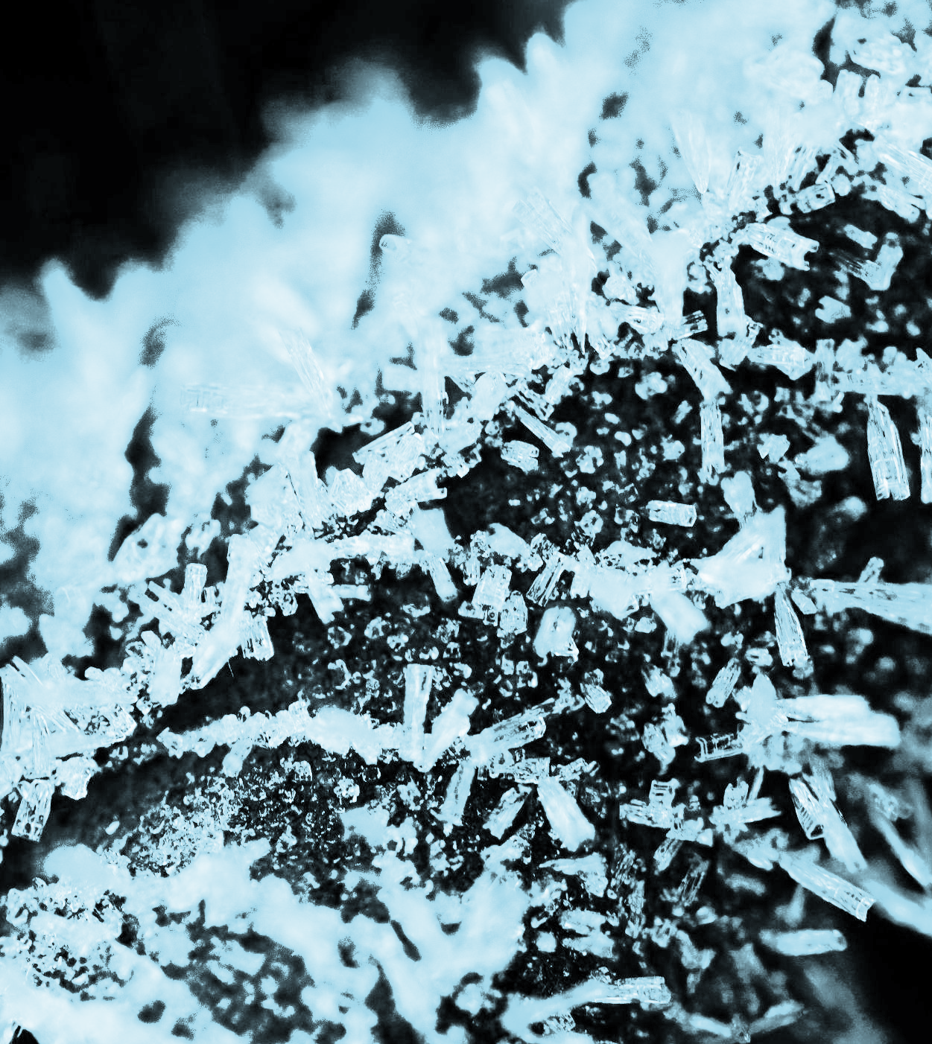
INTRODUCTION
HOME Introduction Question Explanation
Rishika Pathak
IC-2K20-68 MCA(5-Years) 8th Semester International Institute of Professional Studies, Devi Ahilya University

Slide 3
Question 21
HOME Introduction Question Explanation
Consider the CFG with {S,A,B} as the non terminal alphabets i{a,b} as the terminal alphabets S as the start Symbol and the following set of production rules
S->Ab S->bA
B-> b B-> bS B-> aBB
A-> a A->aS A-> bAA
Which of the following strings is generated by the grammar
aaaabb
aabbbb
aabbab
abbbba

Slide 4
Explanation
HOME Introduction Question Explanation
aaaabb is generated by the grammar.
Why it's incorrect:
Starting from the start symbol S, the only way to generate the string "aaaabb" is to follow the production S -> Ab, which then would lead to generating strings starting with 'a', followed by 'b', and then followed by another 'b' through productions A -> aS -> aaBB -> aabB -> aabb.
However, this process cannot lead to the string "aaaabb" as there are no production rules to generate the third 'a' in the string.

Slide 5
Explanation
HOME Introduction Question Explanation
aabbbb is generated by the grammar.
Why it's incorrect:
Starting from the start symbol S, the only way to generate the string "aabbbb" is to follow the production S -> Ab, which then would lead to generating strings starting with 'a', followed by 'b', and then followed by another 'b' through productions A -> aS -> aaBB -> aabB.
However, this process cannot lead to the string "aabbbb" as there are no production rules to generate the third 'b' in the string.

Slide 6
Explanation
HOME Introduction Question Explanation
aabbab is generated by the grammar.
Why it's correct:
Starting from the start symbol S, the grammar can generate the string "aabbab" by following the production S -> Ab -> aSb -> aaBBb -> aabBb -> aabbBb -> aabbaBb -> aabbab.
Each step in the derivation follows a valid production rule in the grammar, leading to the generation of the string "aabbab".

Slide 7
Explanation
HOME Introduction Question Explanation
abbbba is generated by the grammar.
Why it's incorrect:
Starting from the start symbol S, there is no production rule that can directly lead to generating the string "abbbba".
While the grammar can generate strings containing 'a's and 'b's, it cannot generate the specific pattern "abbbba" based on the given production rules.

